Slide 1

Department of Computer Science, CUI Lahore Campus
Formal Methods in Software Engineering
By
Farooq Ahmad

Slide 2
Coverability Graph of Petri net
Petri net Model and its Mathematical Definition

Slide 3
Modelling
States of a process or a system are modelled by tokens in places and state transitions leading from one state to another are modelled by transitions.
Tokens represent objects (humans, goods, machines), information, conditions or states of objects.
Places represent buffers, channels, geographical locations, conditions or states.
Transitions represent events, transformations or transportations.
Reachable marking A marking is said to be reachable if it can be reached by firing a sequence of enabled transitions form the initial marking of a Petri net.

Slide 4
Exercise: readers and writers
begin
receive_mail
mail_box
rest
rest
type_mail
read_mail
send_mail
ready
How many states are reachable?
How to model the situation with 2 writers and 3 readers?
How to model a "bounded mailbox" (buffer size =4)?

Slide 5
Restaurant
Waiter
free
Customer 1
Customer 2
Take
Order 1
Take
Order 2
Wait 1
Order
taken
Wait 2
Eating 1
Eating 2
Tell
kitchen
Serve food 1
Serve food 2

Slide 6
A Puzzle: Crossing River
A ferry-man has to bring a goat, a cabbage, and a wolf safely from the left bank to the right bank of a river.
The ferry-man can cross the river alone or with exactly one of these three passengers.
At any time, either the ferry-man should be on the same bank as the goat, or the goat should be alone on a bank.
Otherwise, the goat could go ahead and eat the cabbage or the wolf may eat the goat

Slide 7
Modelling
We are going to model the situation with a Petri net.
The puzzle mentions the following objects:
Man, wolf, goat, cabbage, boat.
The puzzle mentions the following actions:
Crossing the river, wolf eats goat, goat eats cabbage.
Objects and their states are modeled by places.
Actions are modeled by transitions.
Actually, we can omit the boat, because it is always going to be on the same side as the man.

Slide 8
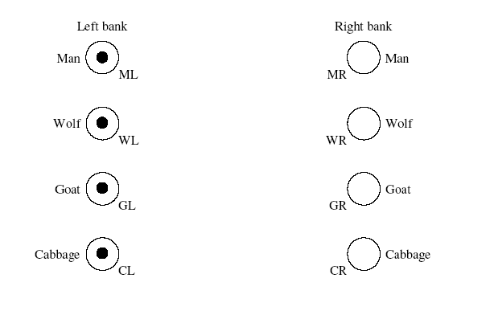
Places

Slide 9
A manufacturing system with a single machine and a buffer
Events:
A part arrives
The machine starts processing
The machine ends processing
During processing, machine may fail
If machine fails, it will be repaired
After repaired, processing continues
Buffer size is one. When machine starting processing, buffer is available for a new part

Slide 10
Multiplicity of arcs
Firing a transition may require multiple tokens from an input place and output multiple tokens to an output place.
This is modeled by multiplex arcs.
Model 2H₂ + O₂ = 2H₂O
Model 2HCl + 2 Na → 2 NaCl + H₂
2
2
2
2

Slide 11
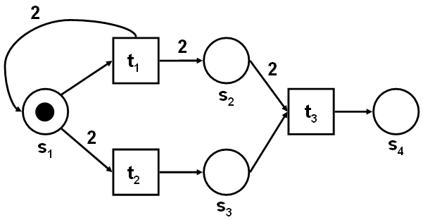
Exercise
Compute the marking of the net after the following transitions t1, t2, t3 have fired.

Slide 12
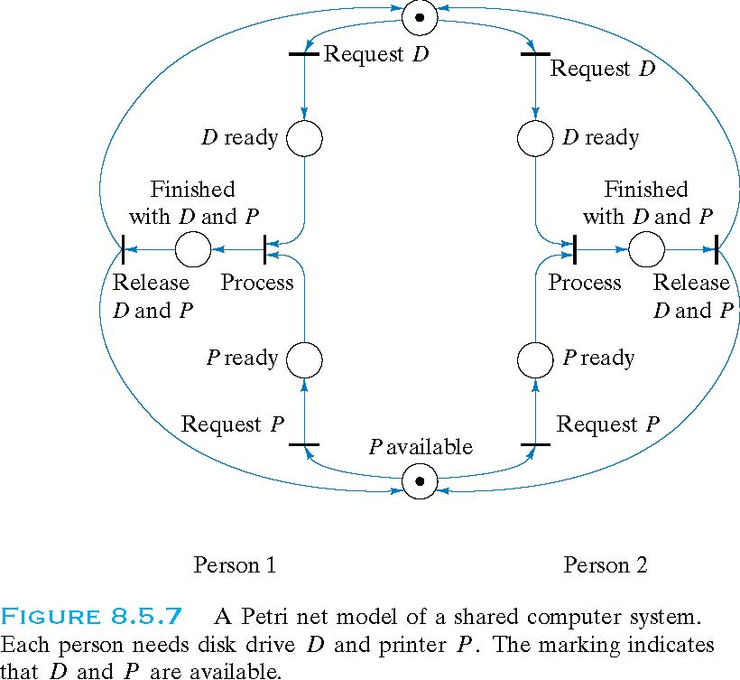
Resource sharing and deadlock

Slide 13
Mathematical Definition of Petri Nets
A Petri net N is a tuple N = （P, T, I, O, M₀）, where
P is a finite set of places, graphically represented by circles
T is a finite set of transitions, graphically represented by boxes
Places P and transitions T are disjoint (P ∩ T = φ),
I: P × T → N (N = {0, 1, 2, …}) is the pre-incidence function representing input arcs,
O: T × P → N (N = {0, 1, 2, …}) is the post-incidence function representing output arcs,
M₀ : P → N is the initial marking representing the initial distribution of tokens.

Slide 14
Transition Firing in Petri Nets
A transition t is enabled at marking M_{i} if and only if
M_{i} ≥ I(t)
Let E(M_{i}) be the set of all transitions enabled at M_{i}. Then t ∈ E(M_{i}).
Suppose that the firing of t takes the Petri net from M_{i} to M_{j}. Then
M_{j} = M_{i} - I(t) + O(t)
Denoted by M_{i}[t>M_{j}
Example
t1
p1
p2
P = {p1, p2}
T = {t1, t2, t3}
I(t1) = (1, 1), I(t2) = (2, 0), I(t3) = (0, 2)
O(t1) = (1, 0), O(t2) = (0, 1), O(t3) = (0, 1)
M₀ = (3, 2)
E(M₀) = {t1, t2, t3}
M₀[t1> M₁ where M₁ = (3, 1)
t2
t3

Slide 15
Exercise
Mathematical definition
Markings after firing t1 and t2
p₂
t₂
2
p₁
2
p₄
t₁
p₃
t₃

Slide 16
Reachability Tree and Reachability Graph
The reachability tree for a Petri net N is constructed by the following algorithm.
Label the initial marking M₀ as the root and tag it “new”.
For every new marking M:
2.1 If M is identical to a marking already appeared in the tree, then tag M“old” and go to another new marking.
2.2 If no transitions are enabled at M, tag M “dead-end” and go to another new marking.
2.3 While there exist enabled transitions at M, do the following for each enabled transition t at M:
2.3.1 Obtain the marking M′ that results from firing t at M.
2.3.2 Introduce M′ as a node, draw an arc with label t from M to M′, and
tag M′ “new”.
Merging the same nodes in a reachability results in a reachability graph.

Slide 17
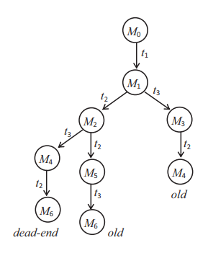
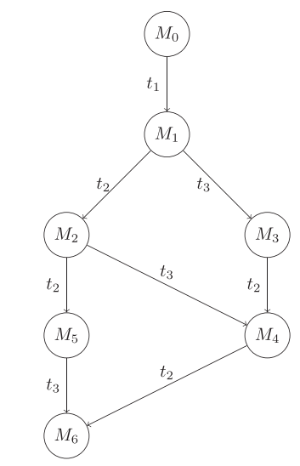
Example
p₂
t₂
2
p₁
2
p₄
M₀ = (2, 0, 0, 0),
M₁ = (0, 2, 1, 0),
M₂ = (0, 1, 1, 1),
M₃ = (0, 2, 0, 1),
M₄ = (0, 0, 1, 2),
M₅ = (0, 1, 0, 2),
M₆ = (0, 0, 0, 3)
t₁
p₃
t₃

Slide 18
Boundedness
In a Petri net, places are often used to represent information storage areas in communication and computer systems, product and tool storage areas in manufacturing systems, and so on.
It is important to be able to determine whether proposed control strategies prevent overflows from these storage areas.
The Petri net property that helps to identify the existence of overflows in the modeled system is the concept of boundedness.

Slide 19
Liveness
In computer science, deadlock refers to a specific condition in which the processes of a group are each waiting for another process to perform some action.
The result is that none of the processes in that group are able to perform an action. Deadlock often results from resource sharing and synchronization of parallel processes.
Deadlock has been studied extensively in the context of computer operating systems. Liveness is a concept closely related to deadlock.
A Petri net modeling a deadlock-free system must be live. Liveness implies the absence of total or partial deadlock and is often required for well-designed systems. But the reverse is not true. We can have a system that avoids deadlock, but is not live.

Slide 20
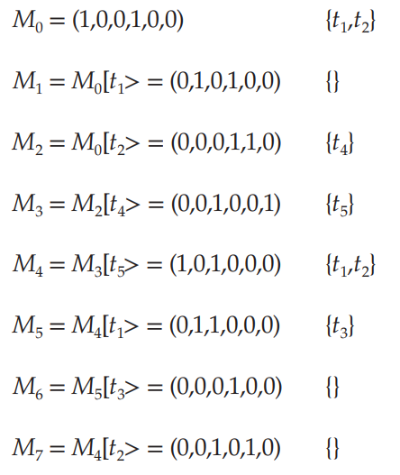
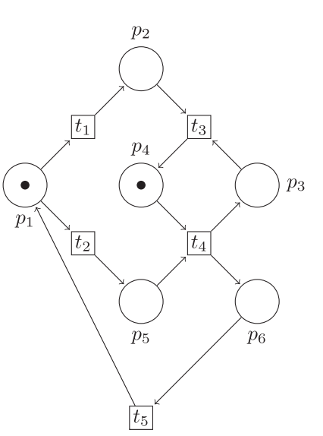
Safe and L1 – Live net

Slide 21
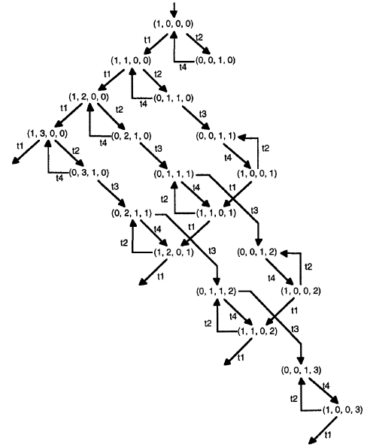
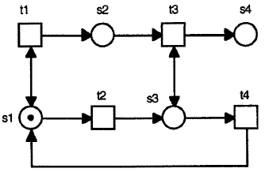

Slide 22
ω -Markings
We introduce a new symbol ω to represent “arbitrarily many” tokens.
We extend the arithmetic on natural numbers with ω as follows. For all natural number n:
n + ω = ω +n = ω,
ω + ω = ω,
ω − n = ω,
0 · ω = 0, ω · ω = ω,
n · ω = ω · n = ω,
Note: ω − ω remains undefined, but we will not need it.
We will extend the notion of markings to ω-markings. In an ω-marking, each place p will either have n tokens, or ω tokens (infinitel12 many).

Slide 23
Firing Rule and ω-Markings
The firing condition and firing rule for normal marking cases can be neatly extended to ω-markings with the extended arithmetic rules.
Basically, if a transition has a place with ω tokens in its preset, that place is considered to have sufficiently many tokens for the transition to fire, regardless of the arc weight.
If a place contains an ω-marking, then firing any transition connected with an arc to that place will not change its marking.
An ω-marking M’ covers an ω-marking M, denoted by M ≤ M’, iff
M(p) ≤ M’(p) for all p ∈ P.

Slide 24
Coverability and Transition Sequences
Observation: Let M and M’ be two reachable markings such that M ≤ M’. Then for all transitions t, the following holds:
If t ∈ E(M) then t ∈ E(M’)
In other words, if M’ has at least as many tokens as M has (on each place), then M’ enables at least the same transitions as M does.
This observation can be extended to sequences of transitions:
If transition sequence t₁t₂...t_{n} is firable from M, so is it from M’

Slide 25
Coverability and Transition Sequences (cont.)
Assume that M’ ∈ R(M) (with M < M’). Then clearly there is some sequence of transitions t₁t₂...t_{n} such that M[t₁t₂...t_{n} >M’. Thus, there is a marking M’’ such that M’[t₁t₂...t_{n} > M’’.
Let ΔM = M’ − M (place-wise difference). Because M < M’, the values of ΔM are non-negative and at least one value is non-zero. Then
M’’ = M’ + M = M +2ΔM.
Therefore, by firing the transition sequence t₁t₂...t_{n} repeatedly we can “pump” an arbitrary number of tokens to all the places having a non-zero entry in ΔM.
The basic idea for constructing the coverability graph is now to
replace the marking M with a marking where all the places with non-zero tokens in ΔM are replaced by ω.

Slide 26
Algorithm for generating the coverability tree
Step 1) Label the initial marking M₀ as the root and tag it “new”.
Step 2)While “new” markings exist, do the following:
Step 2.1) Select new marking M.
Step 2.2) If M is identical to a marking on the path from the root to M, then tag M “old” and go to another new marking.
Step 2.3) If no transitions are enabled at M, tag M “dead-end”.
Step 2.4) While there exist enabled transitions at M, do the following for each enabled transition t at M:
Step 2.4.1) Obtain the marking M’ that results from firing t at M.
Step 2.4.2) On the path from the root to M if there exists a marking M’’ such that M’(p) ≥ M’’(p) for each place p and
M’ ≠ M’’, i.e., M’’ is coverable, then replace M’(p) by ω for each p such that M’(p) > M’’(p).
Step 2.4.3) Introduce M’ as a node, draw an arc with label t from M to M’, and tag M’ “new”.

Slide 27
Example
M0=(100)
M0=(100)
t1
t3
p1
M1=(001)
“dead end”
M2=(1ω0)
t3
t1
t3
p2
t1
t0
M3=(0ω1)
M5=(1ω0)
“old”
t2
t2
p3
M4=(0ω1)
“old”
For the initial marking M0 = (100), the two transitions t1 and t3 are enabled.

Slide 28
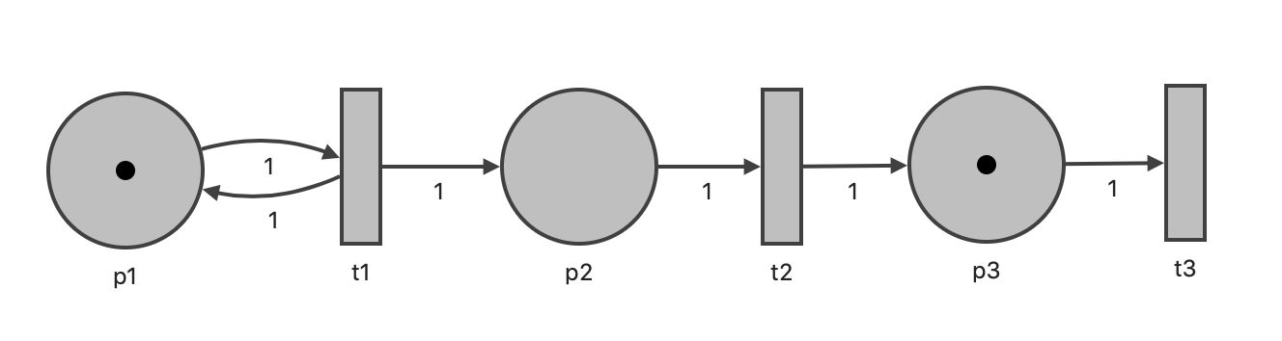
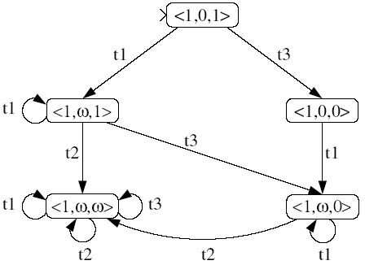
Coverability Graph: Example 1

Slide 29
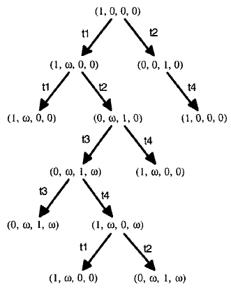
Finite coverability-tree constructed by introducing “ω” for infinite reachability tree
old
old
old
old
old
old

Slide 30
Exercise: Construct coverability graph

Slide 31
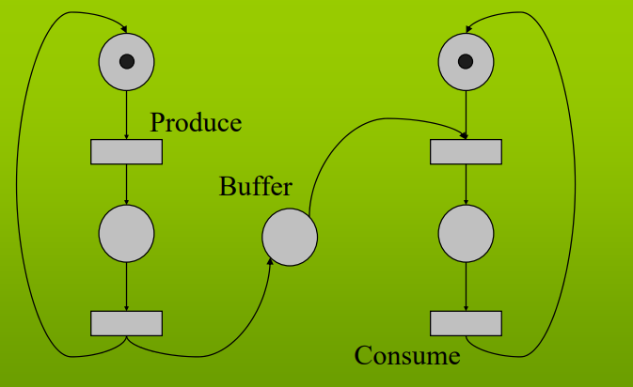
Solution:

Slide 32
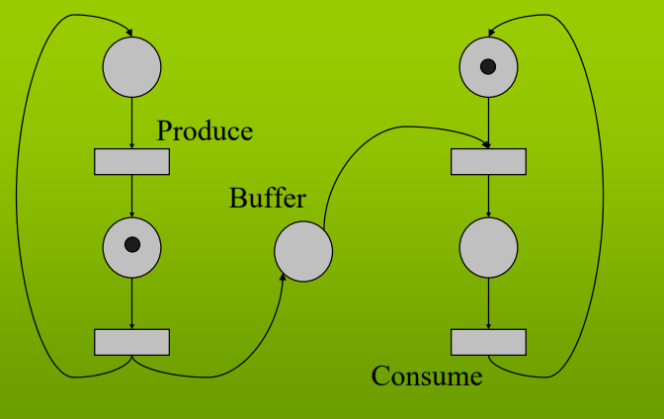

Slide 33
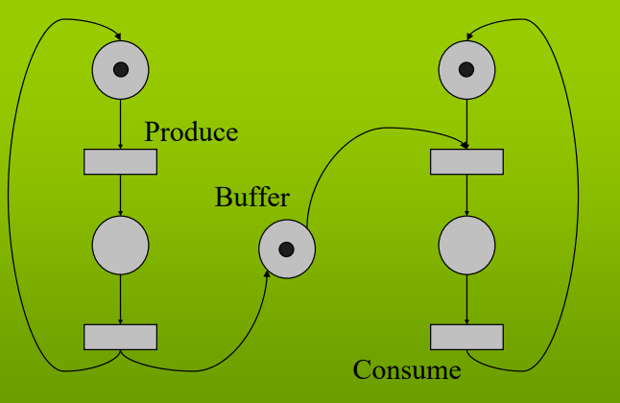

Slide 34
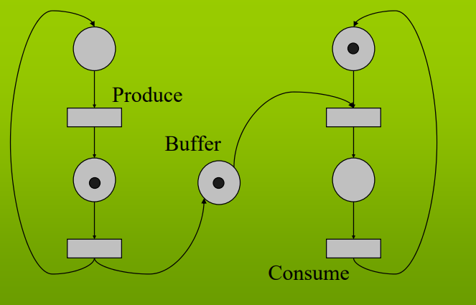

Slide 35
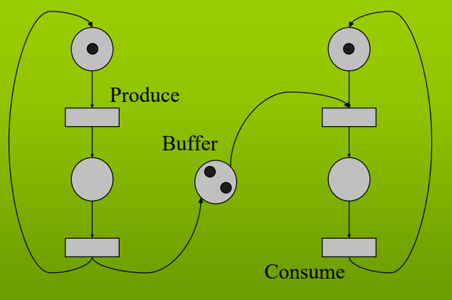

Slide 36
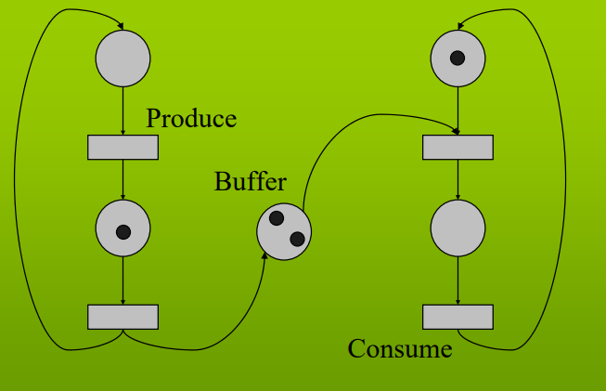

Slide 37
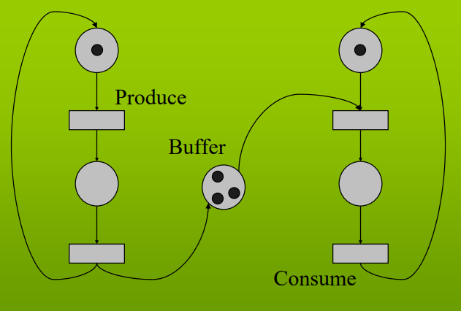

Slide 38
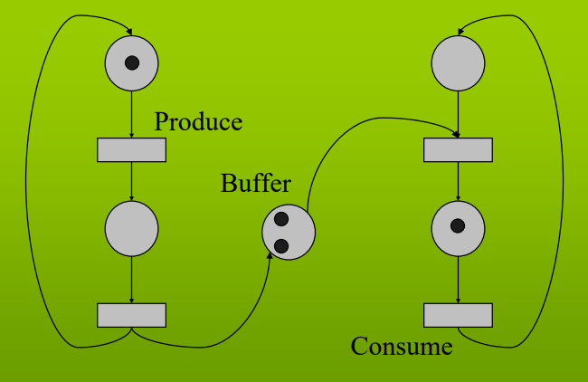

Slide 39
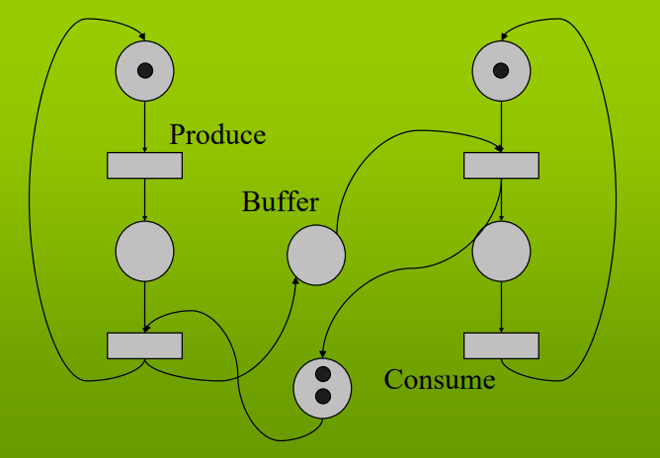
After Adding safe condition:

Slide 40
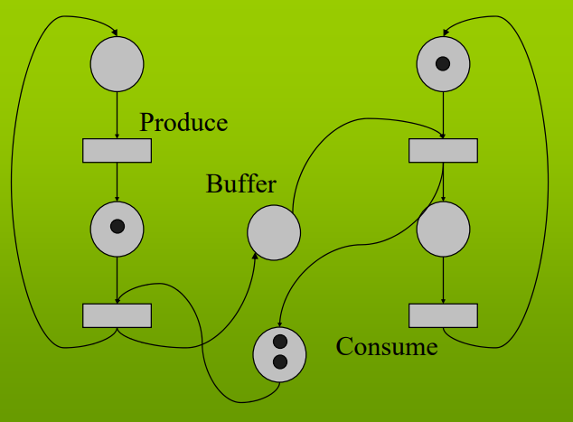

Slide 41
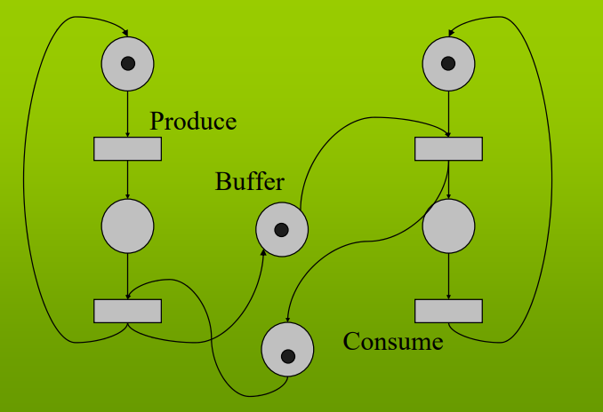

Slide 42
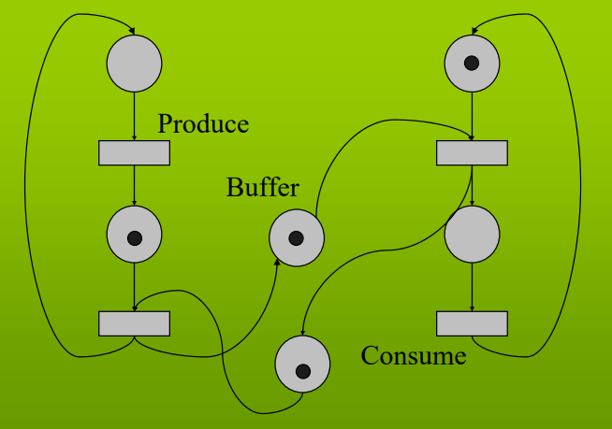

Slide 43
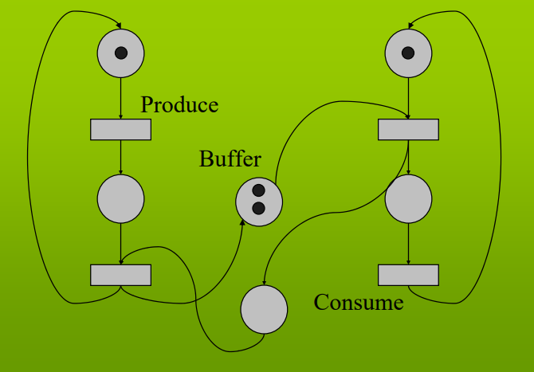

Slide 44
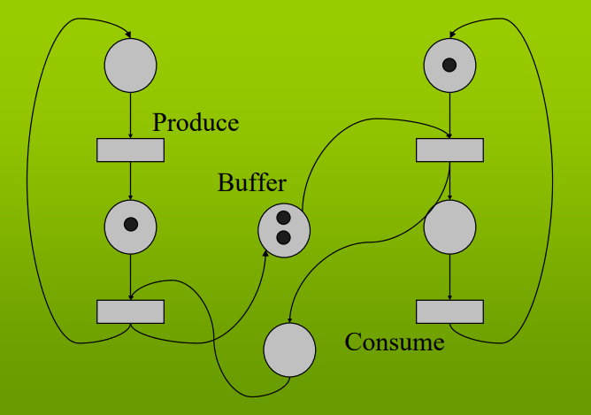

Slide 45
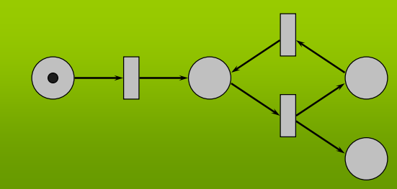
Boundedness illustration:

Slide 46
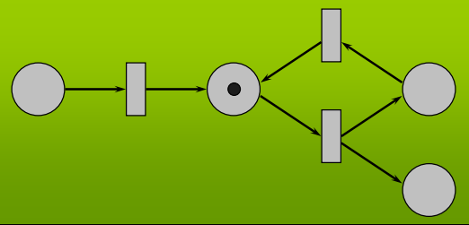

Slide 47
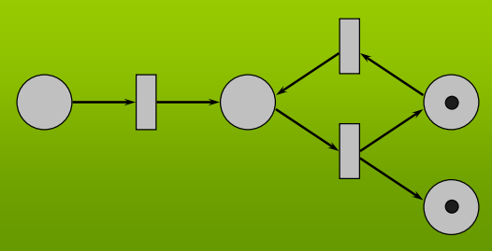

Slide 48
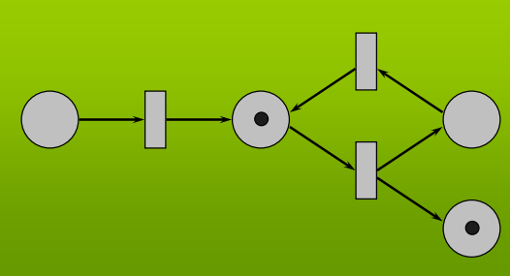

Slide 49
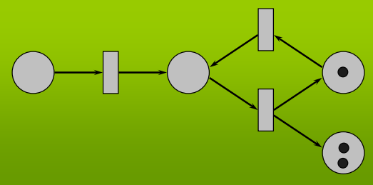

Slide 50
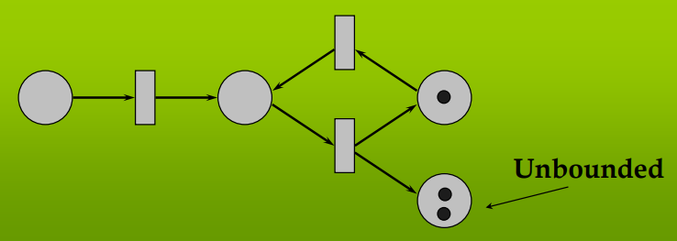

Slide 51
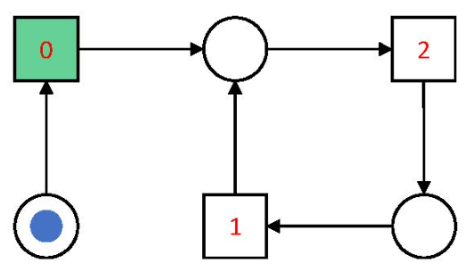
Liveness:
A state is live if there is no deadlock. We can reach at every state more than one time or easily reachable. Reachability tree helps to determine liveness of a petri net. Hint: To easily determine liveness, simply put green color on initial state and if each state can turn green more then one time, than petri net is live.

Slide 52
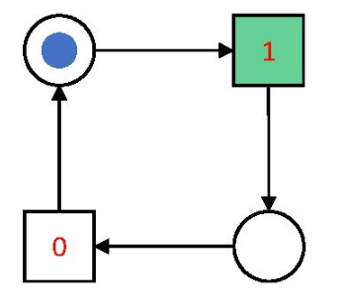
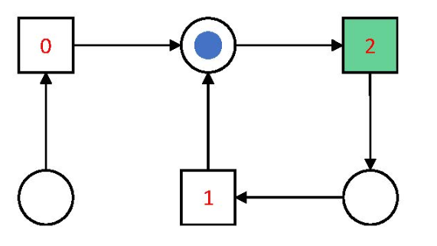
Cont.
Live
Not Live (State-1 is never reachable)

Slide 53
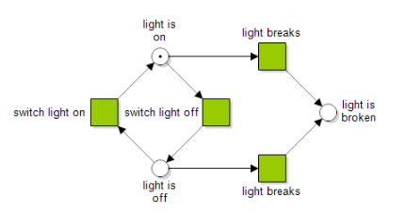
Check liveness and determine reachability tree and graph:

